Slide 1
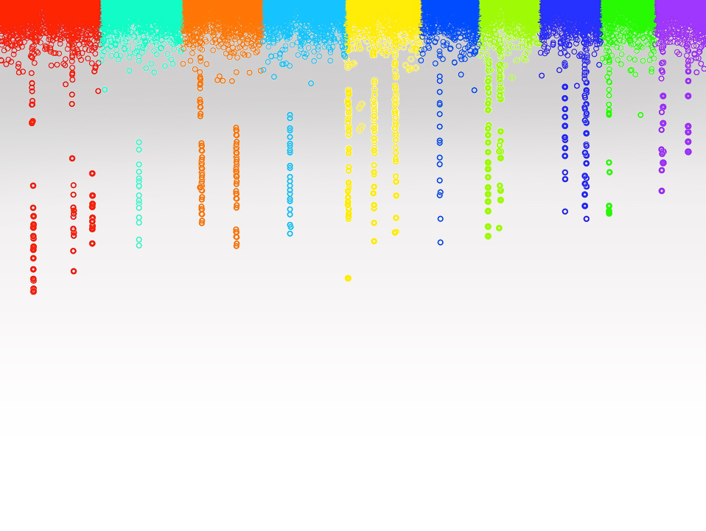

Statistical Genomics
Lecture 27: Bayesian methods
Zhiwu Zhang
Washington State University

Slide 2
Administration
Last homework due on April 27 (Friday), 3:10pm
Final exam: May 2, 3:10-5:10, 50 questions
Student evaluation available: Goal is 100% participation

Slide 3
Outline
Modeling prediction
Bayesian likelihood for genomic prediction
Gibbs sampling
Bayesian implementation
Bayesian alphabet

Slide 4
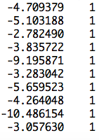
Marker assisted selection
Least Square Error (LSE)
observation
mean
SNP1 | SNP2 | … | SNP4 | SNP5
b1 | b2 | … | b4 | b5
0 | 1 | … | 2 | 0
2 | 2 | … | 0 | 2
2 | 0 | … | 2 | 2
0 | 2 | … | 0 | 0
b0
]
[
b=
y
x1
x2
x5
x6
x0
]
[
X=
y = x₀b₀ + x₁b₁ + x₂b₂ + ... + x₅b₅ + e

Slide 5
More markers
Small n and big p problem
observation
mean
SNP1 | SNP2 | … | SNPp-1 | SNPp
g1 | g2 | … | gp-1 | gp
0 | 1 | … | 2 | 0
2 | 2 | … | 0 | 2
2 | 0 | … | 2 | 2
0 | 2 | … | 0 | 0
μ
]
[
b=
y
x1
x2
xp-1
xp
x0
]
[
X=
y = x₀μ + x₁g₁ + x₂g₂ + ... + x_{p}g_{p} + e

Slide 6
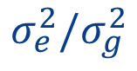
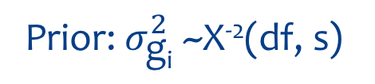
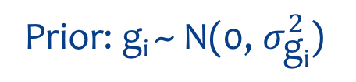
Modeling prediction
LASSO
Least Square Error
Sum(|b|)<t
y = x₀b₀ + x₁b₁ + x₂b₂ + ... + x_{p}b_{p} + e
$$σ_{e}^{2}/σ_{g}^{2}$$
RR: -2Ln(L)
Likelihood: -2Ln(L)
Prior: g_{i} ~ N(0, $σ_{\text{g}\text{i}}^{2}$)
Prior: $σ_{\text{g}\text{i}}^{2}$~X⁻²(df, s)
Bayesian likelihood
(Posterior)
BIC: -2Ln(L) + Ln(n)p

Slide 7
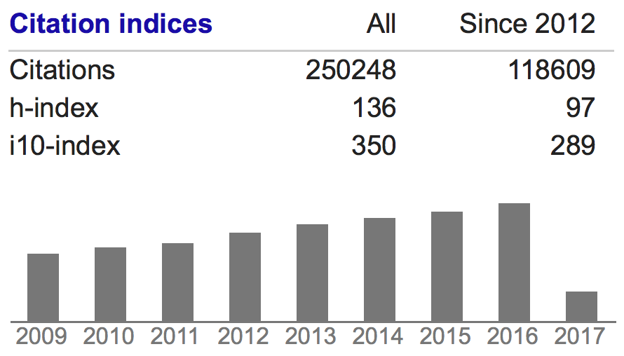
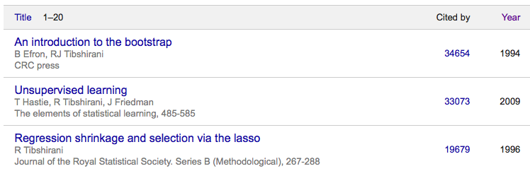
LASSO
Least Absolute Shrinkage and Selection Operator
Robert Tibshirani

Slide 8
Treat markers as random effects with identical independent distribution (iid)
EMMA
Ridge Regression/BLUP
N(0, I σ_{g}²)
y=x₁g₁ + x₂g₂ + … + x_{p}g_{p} + e

Slide 9
Control of unknown parameters
Prior distribution
N(0, I σ_{g1}²)
N(0, I σ_{g2}²)
…
N(0, I σ_{gp}²)
y=x₁g₁ + x₂g₂ + … + x_{p}g_{p} + e

Slide 10
Selection of priors
Flat
Some distributions
RR
Bayes
Prior distributions of
σ_{gi}²

Slide 11
One choice is inverse Chi-Square
σ_{gi}²~X⁻²(v, S)
Hyper parameters
Bayes A
N(0, I σ_{g1}²)
N(0, I σ_{g2}²)
…
N(0, I σ_{gp}²)
y=x₁g₁ + x₂g₂ + … + x_{p}g_{p} + e

Slide 12
Bayesian likelihood
Posterior distribution of θ given y
θ(parameters)
y(data)
P(θ | y)
P(Boy | Pants)
$$∝$$
P(Pants | Boy) P(Boy)
Likelihood of data given parameters
P(y|θ)
Distribution of parameters (prior)
P(θ)

Slide 13
Bayesian likelihood
P(g_{i}, σ_{gi}², σ_{e}² v, s | y) =
P(y | g_{i}, σ_{gi}², σ_{e}² v, s) P(g_{i}, σ_{gi}², σ_{e}² v, s)
Gibbs sampling

Slide 14
Gibbs sampling
Josiah Willard Gibbs
Described by Stuart and Donald Geman in 1984
Difficult
Joint distribution of x and y
Starting values of x and y
Marginal distribution of x given y
Easy
Marginal distribution of y given x

Slide 15
Example
r=75%
?
x=rnorm(10000)
y=rnorm(10000)
plot(x,y)

Slide 16
Example
gibbs=function (n=10000, r=.75, sd=1)
{
mat=matrix(ncol = 2, nrow = n)
x=-5
y=5
mat[1, ]=c(x, y)
for (i in 2:n) {
x=rnorm(n=1, mean=r*y, sd=1)
y=rnorm(n=1, mean=r*x, sd=1)
mat[i, ]=c(x, y)
}
mat
}
n= 10000
bvn<-gibbs(n,.75, sd=1)
cor(bvn)
batch=5000
ndisp=1000
xlim=c(min(bvn[,1]),max(bvn[,1]))
ylim=c(min(bvn[,2]),max(bvn[,2]))
for(i in 1:n){
if(i==1)plot(bvn[i,1],bvn[i,2],xlim=xlim,ylim=ylim,pch=20,col="red")
if(i<ndisp&i>1)points(bvn[i,1],bvn[i,2],pch=20)
if(i>ndisp)points(bvn[i,1],bvn[i,2],col=floor(i/batch)+1)
if(i<ndisp)Sys.sleep(1/i)
if(i==ndisp)Sys.sleep(2)
if(floor(i/batch)*batch==i) Sys.sleep(1)
}
x=-5
y=5
Starting values
x=rnorm(n=1, mean=.75*y, sd=1)
y=rnorm(n=1, mean=.75*x, sd=1)

Slide 17
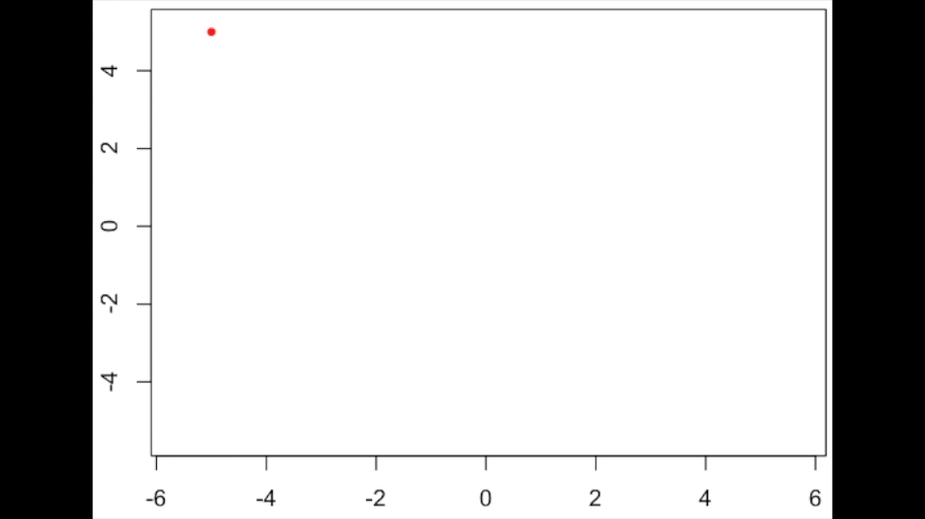
Gibbs sampling

Slide 18
Distribution of the correlations (500 replicates)

Slide 19
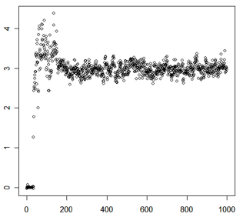
Markov chain Monte Carlo (MCMC)
Sample value
Burn in
Converge
Start
Iteration

Slide 20
Implementation in R
Bayesian Alphabet for Genomic Selection (BAGS)
source("http://www. zzlab.net/sandbox/BAGS.R
Based on the source code originally developed by Rohan Fernando (http://taurus.ansci.iastate.edu/wiki/projects)
Intensively revised
Methods: Bayes A, B and Cpi

Slide 21
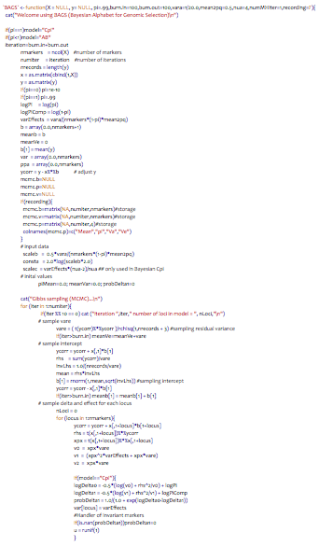
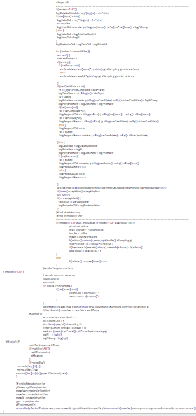
BAGS.R
varCandidate = var[locus]*2 /rchisq(1,4)
vare = ( t(ycorr)%*%ycorr )/rchisq(1,nrecords + 3)
varEffects = (scalec*nua + sum)/rchisq(1,nua+countLoci)
b[1+locus]= rnorm(1,mean,sqrt(invLhs))
b[1] = rnorm(1,mean,sqrt(invLhs))

Slide 22
Variation of assumption
σ_{gi}²>0 for all i
Bayes A
}
σ_{gi}²=0 with probability π
Bayes B
σ_{gi}²~X⁻¹(v, S) with probability 1-π

Slide 23


Pioneers of Bayesian methods
https://www.youtube.com/watch?v=RovnCsda-zQ

Slide 24
Bayes A
σ_{gi}²~X⁻²(v, S)
Differnt
N(0, I σ_{g1}²)
N(0, I σ_{g2}²)
…
N(0, I σ_{gp}²)
y=x₁g₁ + x₂g₂ + … + x_{p}g_{p} + e

Slide 25
Bayes B
σ_{gi}²~X⁻²(v, S)
Zero
π
1−π
Different
N(0, I σ_{g1}²)
N(0, I σ_{g2}²)
…
N(0, I σ_{gp}²)
y=x₁g₁ + x₂g₂ + … + x_{p}g_{p} + e

Slide 26
Bayes Cpi
σ_{g}²~X⁻²(v, S)
Zero
π
1−π
Common
N(0, I σ_{g1}²)
N(0, I σ_{g2}²)
…
N(0, I σ_{gp}²)
y=x₁g₁ + x₂g₂ + … + x_{p}g_{p} + e

Slide 27
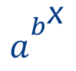
Bayesian LASSO
$a_{}^{b_{}^{\text{x}}}$
Double Exponential
Differnt
N(0, I σ_{g1}²)
N(0, I σ_{g2}²)
…
N(0, I σ_{gp}²)
y=x₁g₁ + x₂g₂ + … + x_{p}g_{p} + e

Slide 28
Bayes alphabet
Method | marker effect | Genomic Effect Variance | Residual variance | Unknown parameter
Bayes A | All SNPs | X⁻²(v,S) | X⁻²(0,-2)
Bayes B | P(1-π) | X⁻²(v,S) | X⁻²(0,-2)
Bayes Cπ | P(1-π) | X⁻²(v,S) | X⁻²(0,-2) | π
Bayes Dπ | P(1-π) | X⁻²(v,S) | X⁻²(0,-2) | S, π
BayesianLASSO | P(1-π) | Double exponential effects |  | λ, t
BayesMulti, BayesR | P(1-π) | Multiple normal distributions |  | γ

Slide 29
Outline
Modeling prediction
Bayesian likelihood for genomic prediction
Gibbs sampling
Bayesian implementation
Bayesian alphabet

